Slide 1
Agile: planning
Digital Sprint - Ghent
19/05/2023

Slide 2
5 levels of Agile Planning
Product Vision
What, Who, Why, When, Constraints, Assumptions
Product Roadmap
Release - Date, Theme/Feature Set, Objective, Development Approach
Release Planning
Iteration, Team Capacity, Stories, Priority, Size, Estimates, Definition of Done
Stories - Tasks, Definition of Done, Level-of Effort, Commitment
Iteration Planning
Daily Planning
What did I do yesterday?
What will I do today?
What is blocking me?

Slide 3
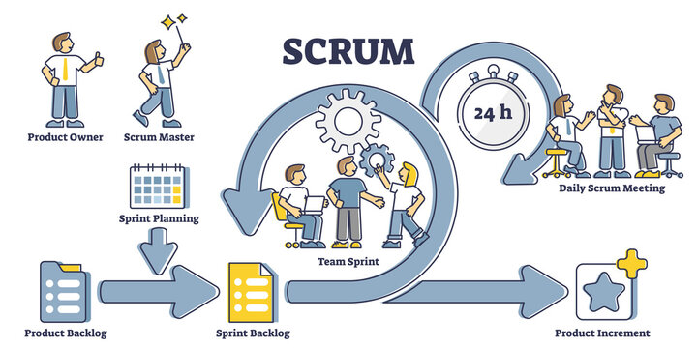
Scrum Methodology

Slide 4
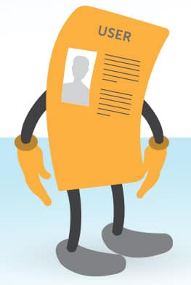
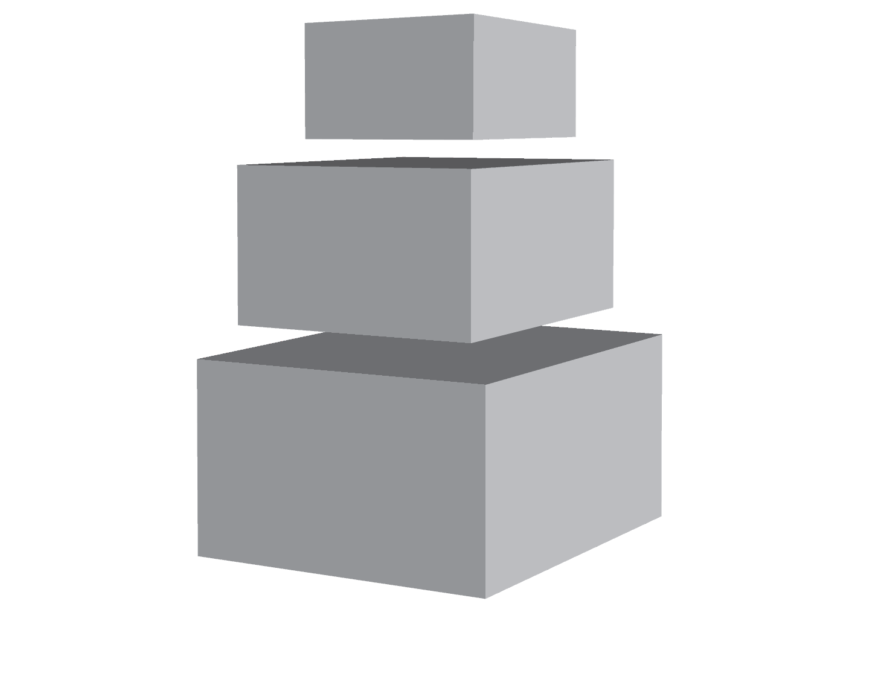
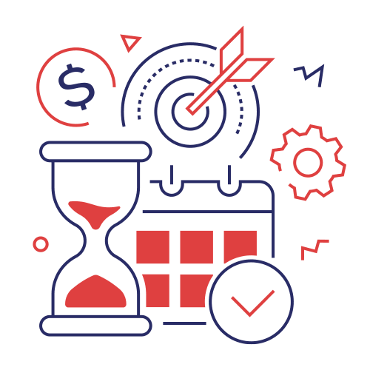
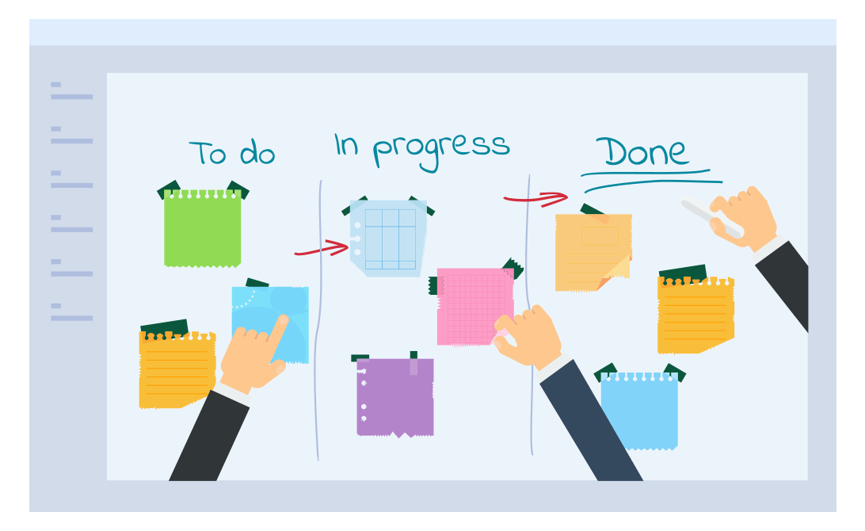
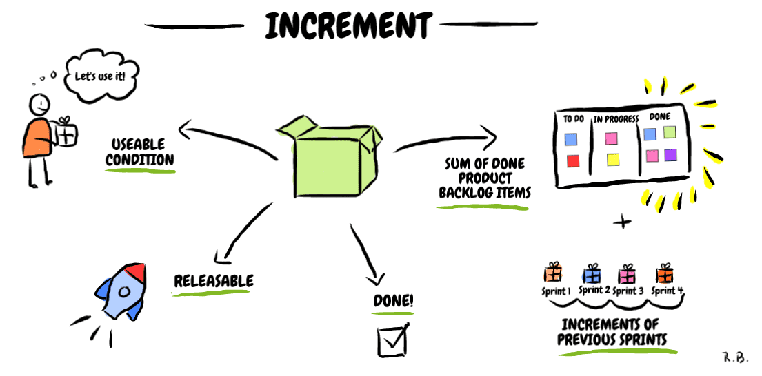

Ok, but what all these mean? 😕
Product Backlog
Sprint Planning
Sprint Backlog
Product Increment
Daily Scrum Meeting

Slide 5







Project management tools

Slide 6
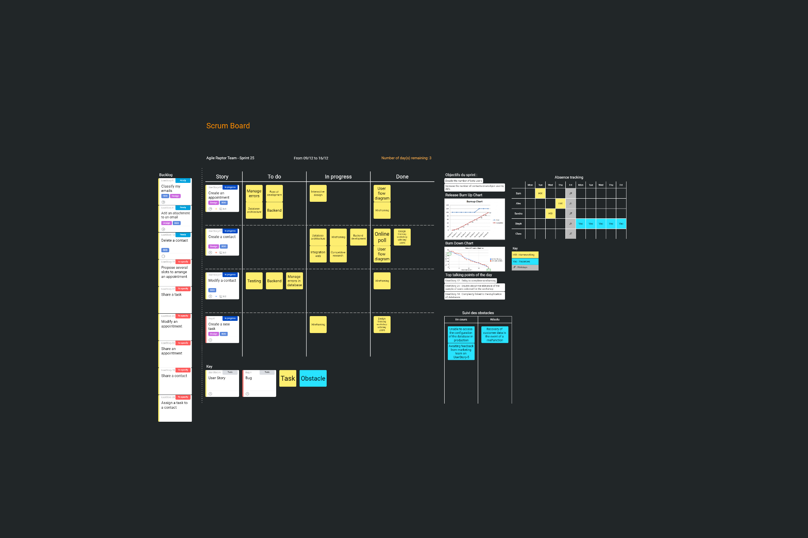
Scrum Board example
See board here: https://draft.io/xche86q47mdnqnfmdnnf5tgmzwr5sp4jh3cyckswude6
Notes:
https://draft.io/xche86q47mdnqnfmdnnf5tgmzwr5sp4jh3cyckswude6

Slide 7

Time to create your planning for the next days

